Slide 1
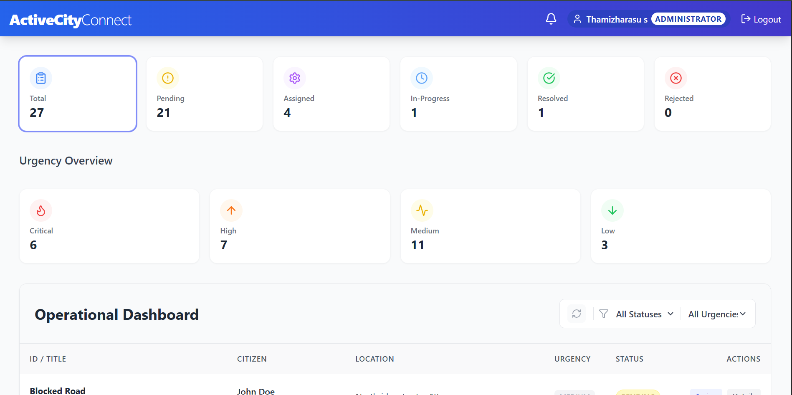
Active City
Administration System
A Summer Internship / Project Review
Submitted by: Thamizharasu S
B.Tech Information Technology | Department of Information Technology
University College of Engineering, BIT Campus
Anna University, Tiruchirappalli
CITIZEN-CENTRED
TRANSPARENT
TRACKABLE

Slide 2
INTERNSHIP ORGANIZATION
About Fantasy Solution
IT solutions and training provider where the internship was undertaken.
COMPANY PROFILE
CORE SERVICES
Fantasy Solution is based at No. 16, Samnath Plazza, Third Floor, near BG Naidu Sweets, Melapudur, Trichy – 620001.
Software development, web design, web hosting, real-time projects and IT training.
TECHNOLOGY AREAS
MISSION & VISION
.NET, PHP, Java, Android applications, MATLAB image processing, NS2, data mining, R and Python.
Mission: deliver quality software, secure access to information and value for customers. Vision: provide strong consulting and business solutions.
Internship connection: the organization’s web development and training activities provided the context for studying website design, responsiveness, usability, security and database connectivity.
02

Slide 3
Making city services easier to access and track
A centralized platform concept for citizen requests, municipal action and transparent status updates.
THE CHALLENGE
THE IDEA
THE VALUE
Manual or disconnected processes can cause delays, paperwork, limited visibility and difficult complaint follow-up.
Bring complaint reporting, service requests, assignment and status tracking into one web-based system.
Help citizens understand progress while giving administrators a structured way to coordinate responses.
PROJECT OBJECTIVE
Create a clear digital workflow from citizen submission to responsible-team assignment, resolution and feedback.
03

Slide 4
02 • USERS & SCOPE
Designed around four key stakeholder roles
Each role has a distinct responsibility in the complaint and service lifecycle.
CITIZEN
ADMINISTRATOR
MUNICIPAL AUTHORITY
NGO / AGENCY
Register or log in, submit a complaint, attach details, track progress and provide feedback.
Review submissions, categorize issues, assign work and monitor service progress.
Receive assigned cases, update action status and report resolution.
Support eligible community issues and coordinate service-related responses.
CORE SCOPE
Citizen registration and secure login
Complaint submission with category and location
Assignment, status updates, notifications, reports and feedback
04

Slide 5
03 • PROBLEM & PROPOSED SOLUTION
From fragmented follow-up to a traceable workflow
The proposed system centralizes information and makes each case easier to monitor.
COMMON PAIN POINTS
PROPOSED SYSTEM RESPONSE
Requests handled across separate channels
→
Central complaint and service-request records
Citizens must repeatedly ask for updates
→
Status tracking and update notifications
Unclear ownership after submission
→
Administrator assignment to responsible teams
Difficult to summarize recurring issues
→
Dashboard views and report generation
ACTIVE CITY ADMINISTRATION SYSTEM • PROJECT REVIEW
05

Slide 6
04 • SYSTEM ARCHITECTURE
A modular web application architecture
Proposed implementation stack: MERN with REST APIs and role-based authentication.
PRESENTATION LAYER
React.js responsive interface • citizen portal • admin dashboard
↓ API ↓
APPLICATION LAYER
Node.js + Express.js • REST APIs • validation • JWT / role checks
↓ CRUD ↓
DATA LAYER
MongoDB collections • users • complaints • categories • assignments • updates
Security foundation: authentication • role-based access • input validation • controlled status changes
ACTIVE CITY ADMINISTRATION SYSTEM • PROJECT REVIEW
06

Slide 7
05 • END-TO-END WORKFLOW
A complaint moves through clear, accountable stages
A simple flow helps citizens understand what happens after submission.
01
→
02
→
03
→
04
→
05
SUBMIT
REVIEW
ASSIGN
UPDATE
CLOSE
Citizen enters details, category and location.
Administrator checks and categorizes the request.
Case is routed to the relevant municipal team or agency.
Responsible team records progress and action taken.
Resolution is recorded; citizen can review and give feedback.
STATUS VISIBILITY
Submitted → Under Review → Assigned → In Progress → Resolved → Feedback
ACTIVE CITY ADMINISTRATION SYSTEM • PROJECT REVIEW
07

Slide 8
06 • FUNCTIONAL BREAKDOWN
Six modules organize the main system capabilities
Modules can be developed and tested independently, then integrated into the full workflow.
User & Access
Complaint Management
Assignment
Registration, login, role-based permissions
Create, categorize, view and track complaints
Allocate cases to municipal teams or agencies
Service Requests
Notifications & Updates
Reports & Feedback
Record requests and manage service progress
Communicate status changes and actions
Summaries, monitoring and citizen feedback
ACTIVE CITY ADMINISTRATION SYSTEM • PROJECT REVIEW
08

Slide 9
07 • DATA & TECHNOLOGY
Core records connect people, complaints and action
Illustrative data model and stack based on the project's previously defined scope.
USER
COMPLAINT
ASSIGNMENT / UPDATE
userId • name • email • phone • role
↔
complaintId • description • date • status
↔
assignee • action • timestamp • remarks
TECHNOLOGY STACK
REST APIs connect the UI and server
JWT supports authenticated sessions
Role-based checks restrict protected actions
MongoDB stores users, complaints and updates
React.js
Node.js
Express.js
MongoDB
ACTIVE CITY ADMINISTRATION SYSTEM • PROJECT REVIEW
09

Slide 10
08 • VALIDATION & EXPECTED OUTCOMES
Test the workflow, access rules and status consistency
Use these checks during demonstration; replace with measured results if you have completed testing.
FUNCTIONAL
ACCESS CONTROL
Can a citizen submit a complaint with required fields?
Can only authorized roles access protected actions?
WORKFLOW
TRACKING
Can an administrator assign a case and update its status?
Can a citizen view the latest status of their own complaint?
DATA VALIDATION
REPORTING
Are missing fields and invalid inputs handled clearly?
Do dashboard summaries reflect stored complaint records?
Review note: this slide lists validation criteria, not claimed test results.
ACTIVE CITY ADMINISTRATION SYSTEM • PROJECT REVIEW
10

Slide 11
09 • CONCLUSION
A more connected way to
manage city services
KEY TAKEAWAYS
Centralized complaint handling
Clear role-based responsibilities
Visible status and accountability
A foundation for data-driven services
Active City Administration System brings citizen requests, case assignment, progress tracking and feedback into a single structured workflow.
Thank you
Questions & discussion
11

